Slide 1

TypeScript
Date
Name
Title

Slide 2
Objectives
Understand TypeScript fundamentals and type system.
Understand TypeScript data types
Work with arrays and functions
Use spread & rest operators
Learn proper usage of var, let, and const
Write type-safe functions and classes
Use types, interfaces, and enums effectively
Notes:
https://www.javabrahman.com/java-8/java-8-java-util-stream-collector-basics-tutorial-with-examples/
https://www.journaldev.com/2763/java-8-functional-interfaces
http://winterbe.com/posts/2014/03/16/java-8-tutorial/
https://www.oreilly.com/learning/java-8-functional-interfaces

Slide 3

ARTIFICIAL INTELLIGENCE Vs. MACHINE LEARNING Vs. DEEP LEARNING
EASY
ADVANCED

Slide 4
ARTIFICIAL INTELLIGENCE Vs. MACHINE LEARNING Vs. DEEP LEARNING Vs. DATA SCIENCE
ARTIFICIAL INTELLIGENCE (AI)
MACHINE LEARNING (ML)
DATA SCIENCE (DS)
DEEP LEARNING (DL)

Slide 5
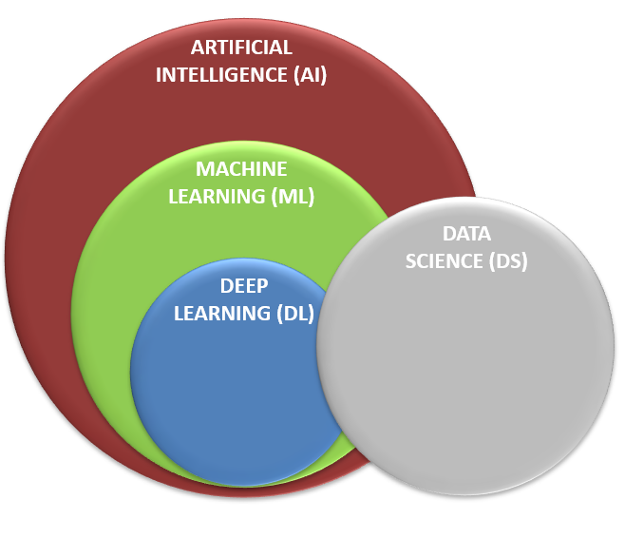

ARTIFICIAL INTELLIGENCE (AI)
AI is the science that enable computers to think like humans.
AI allows computers to imitate human intelligence and do things that humans do!
AI can make decision (Example: buy/sell stocks), understand text (Example: read articles), and detect faces.

Slide 6
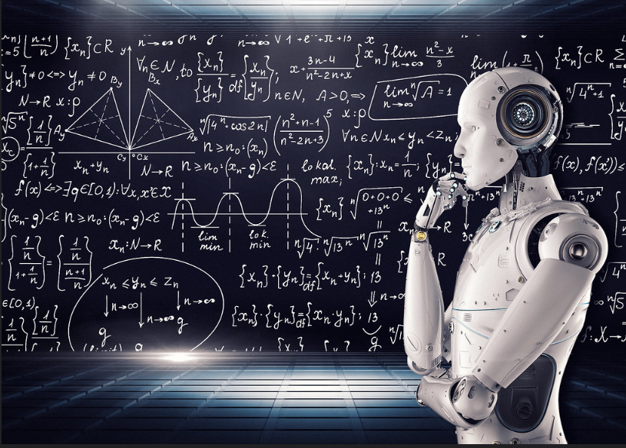
MACHINE LEARNING (ML)
Machine Learning is a subfield of Artificial Intelligence that enables machines to improve at a given task with experience without being explicitly programmed.
Note that all machine learning techniques are classified as Artificial Intelligence. However, not all Artificial Intelligence could count as Machine Learning since some basic Rule-based algorithms could be classified as AI but they do not learn from experience therefore they do not belong to the machine learning category.

Slide 7
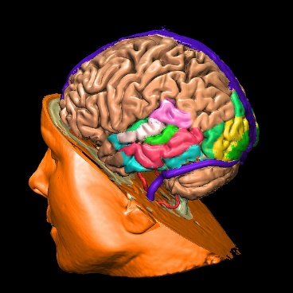
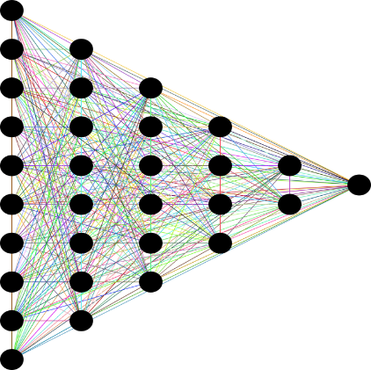
DEEP LEARNING (DL)
Deep Learning is a subset of machine learning that aims at imitating the human brain using mathematical equations.
The human brain consists of billions of neurons that communicate to each other and enable humans to see, think and make decision.
Features from input data are automatically extracted.
INPUTS
OUTPUTS
DEEP LEARNING IMITATES THE HUMAN BRAIN

Slide 8
DATA SCIENCE (DS)
Data science is a science that aims at gaining useful information from the data.
Data science can help companies make better decisions.
For example, a bank can analyze customer data and identify which customers have high credit score and tailor products/services to meet their needs.

Slide 9
MACHINE LEARNING: THE BIG PICTURE
EASY
ADVANCED

Slide 10
What is Machine Learning?
Arthur Samuel, a pioneer of artificial intelligence research defined "machine learning" as " the field of study that gives computers the ability to learn without being explicitly programmed.“
For a given problem, machine learning algorithms are fed with related data. Algorithms then automatically detect the underlying patterns in the given data and use them to make predictions for new data.
For example, if a real estate firm wants to provide its customers a utility to automatically predict the price of a given property. To build this solution, first feed the machine with property-sales data for a given time period (last 3 years). Then let the machine learn various patterns in the data, with the help of which it predicts the price.

Slide 11
What is Machine Learning?
Arthur Samuel, a pioneer of artificial intelligence research defined "machine learning" as " the field of study that gives computers the ability to learn without being explicitly programmed.“
For a given problem, machine learning algorithms are fed with related data. Algorithms then automatically detect the underlying patterns in the given data and use them to make predictions for new data.
For example, if a real estate firm wants to provide its customers a utility to automatically predict the price of a given property. To build this solution, first feed the machine with property-sales data for a given time period (last 3 years). Then let the machine learn various patterns in the data, with the help of which it predicts the price.

Slide 12
What is Machine Learning?
Arthur Samuel, a pioneer of artificial intelligence research defined "machine learning" as " the field of study that gives computers the ability to learn without being explicitly programmed.“
For a given problem, machine learning algorithms are fed with related data. Algorithms then automatically detect the underlying patterns in the given data and use them to make predictions for new data.
For example, if a real estate firm wants to provide its customers a utility to automatically predict the price of a given property. To build this solution, first feed the machine with property-sales data for a given time period (last 3 years). Then let the machine learn various patterns in the data, with the help of which it predicts the price.

Slide 13
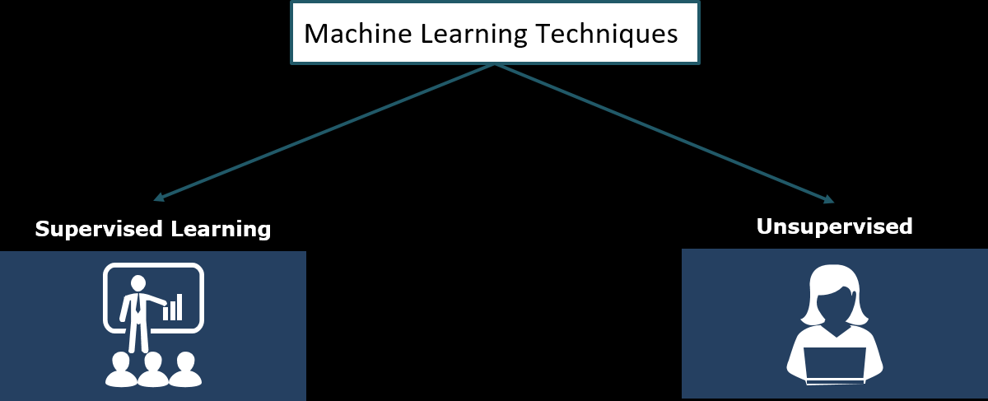
What is Machine Learning?
There are different machine learning techniques or algorithms that are used to learn the patterns.
The choice depends on the type of the prediction problem and the type of the data.
Machine learning techniques can be broadly classified as follows:

Slide 14
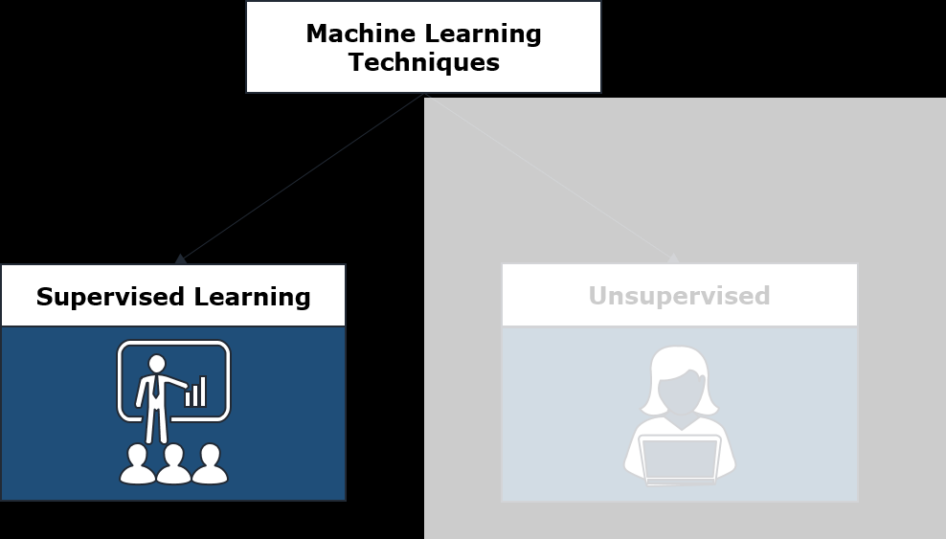
Supervised Machine Learning
Supervised learning works on labelled data. Each input data has a corresponding labelled output. The goal of supervised machine learning is to learn a mapping from the input to the output. The input data is called attributes, features or predictors. This output variable is also called response variable or target variable.

Slide 15
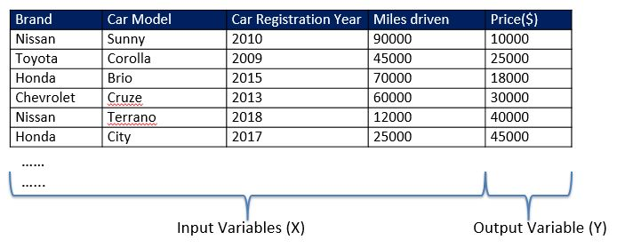
Supervised Machine Learning
For example, the problem of building a utility for predicting the selling price of the car. The dataset is shown below:

Slide 16

Supervised Machine Learning
From the given dataset, the machine learning algorithm learns the mapping from input variables to output variable. This learning is represented in the form of a model. When a new instance is given to the model as shown below, it can predict its output value.

Slide 17
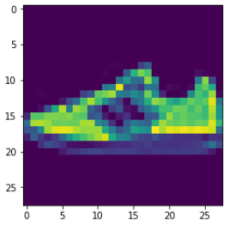
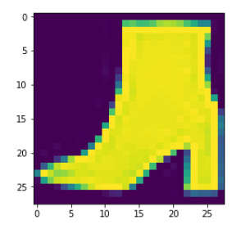
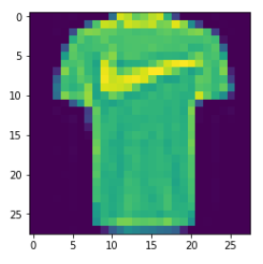
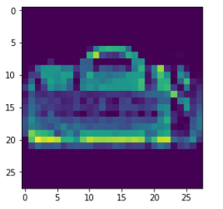

MACHINE LEARNING: SUPERVISED LEARNING
Supervised: used to train algorithms using labeled input and output data.
Performance is assessed by comparing trained model prediction vs. real output.
DESIRED OUTPUT
TARGET CLASSES (LABELS)
y _train
INPUT DATA
$$X _train$$
T-SHIRT/TOP
TROUSER
PULLOVER
DRESS
COAT
SANDAL
SHIRT
SNEAKER
BAG
ANKLE BOOT
MODEL

Slide 18
Supervised Machine Learning
Supervised learning can be further categorized as Regression or Classification.
Regression -- When the output variable can take continuous numerical values, e.g. price of a car, delivery time, credit limit
Classification -- When the output variable takes categorical or discrete (non-continuous) values, e.g. whether an email is a spam, whether a transaction is fraudulent etc.

Slide 19
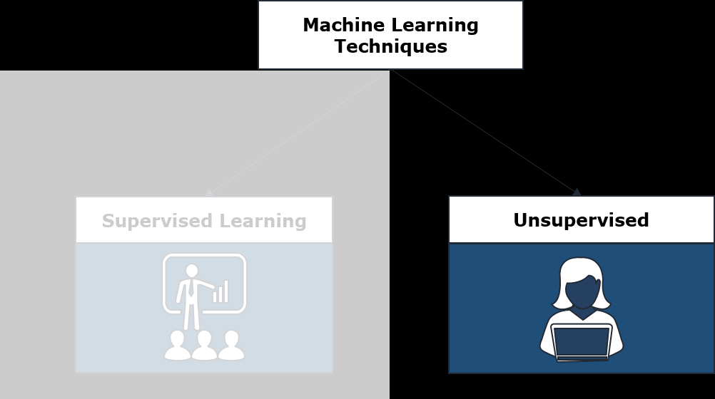
Unsupervised Machine Learning
Unsupervised machine learning has no explicitly defined output. The idea is to discover knowledge or structure in the data.

Slide 20
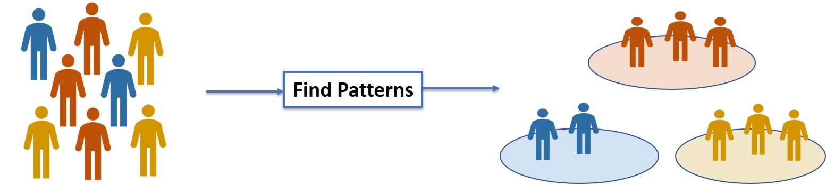
Unsupervised Machine Learning
For example, an online retailer will have data about all items that the customers purchased. Unsupervised learning algorithms can be applied on this data to group customers based on their buying patterns.

Slide 21
MACHINE LEARNING: UNSUPERVISED LEARNING
Unsupervised learning: provides the algorithm with no labeled data.
The algorithm attempts at discovering hidden patterns within the training data.
Unsupervised learning methods can analyze complex data that humans might find difficult to interpret.
No feedback!
DATA CLUSTERS
INPUT DATA
MODEL

Slide 22
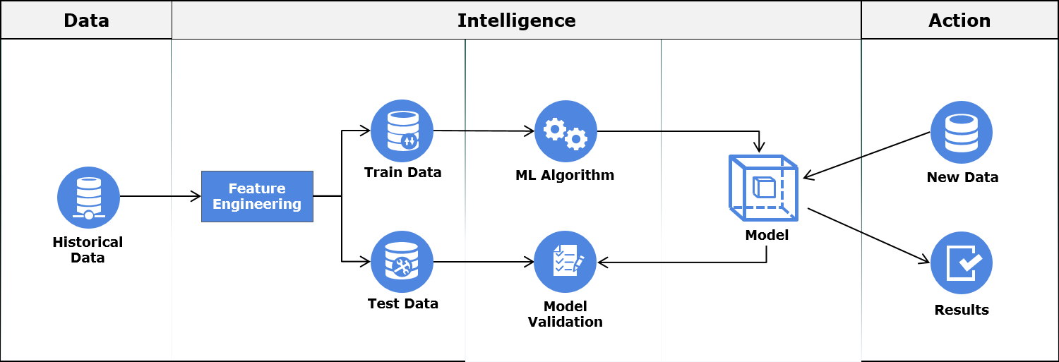
Machine Learning Process
The diagram above illustrates the Machine Learning process.

Slide 23
Machine Learning Process
The diagram above illustrates the Machine Learning process.
In this process, first relevant data is gathered then is cleaned and transformed through a process called Feature Engineering. During the process of Feature Engineering, handling missing value, handling outliers, creating new features out of existing ones are some of the common tasks performed.
After feature engineering, the data is split into Train Data and Test Data. The Train Data is used for training the machine learning model. Once the model is built, it is validated against the Test Data for accuracy. This accuracy helps us in estimating the performance on previously unseen data. If the model performance on both Train and Test Data is satisfactory, the model may be deployed.
Once deployed, the model makes predictions on new data ; these predictions/insights are used to take business decisions.

Slide 24
AI/ML KEY INGREDIENTS
1. DATA
2. MODEL
3. COMPUTE

Slide 25

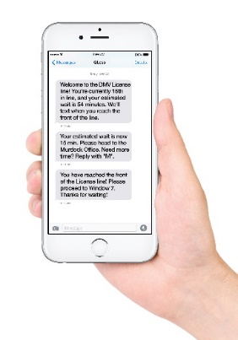



1. DATA
Data can come from so many sources such as images, audio, video, and text.
Collecting, structuring and analysing this data is critical for companies to gain customers insights and set their marketing and product strategies.
IMAGE/VIDEO
TEXT (CORPUS)
AUDIO/SOUND
TIMESERIES/SIGNALS

Slide 26
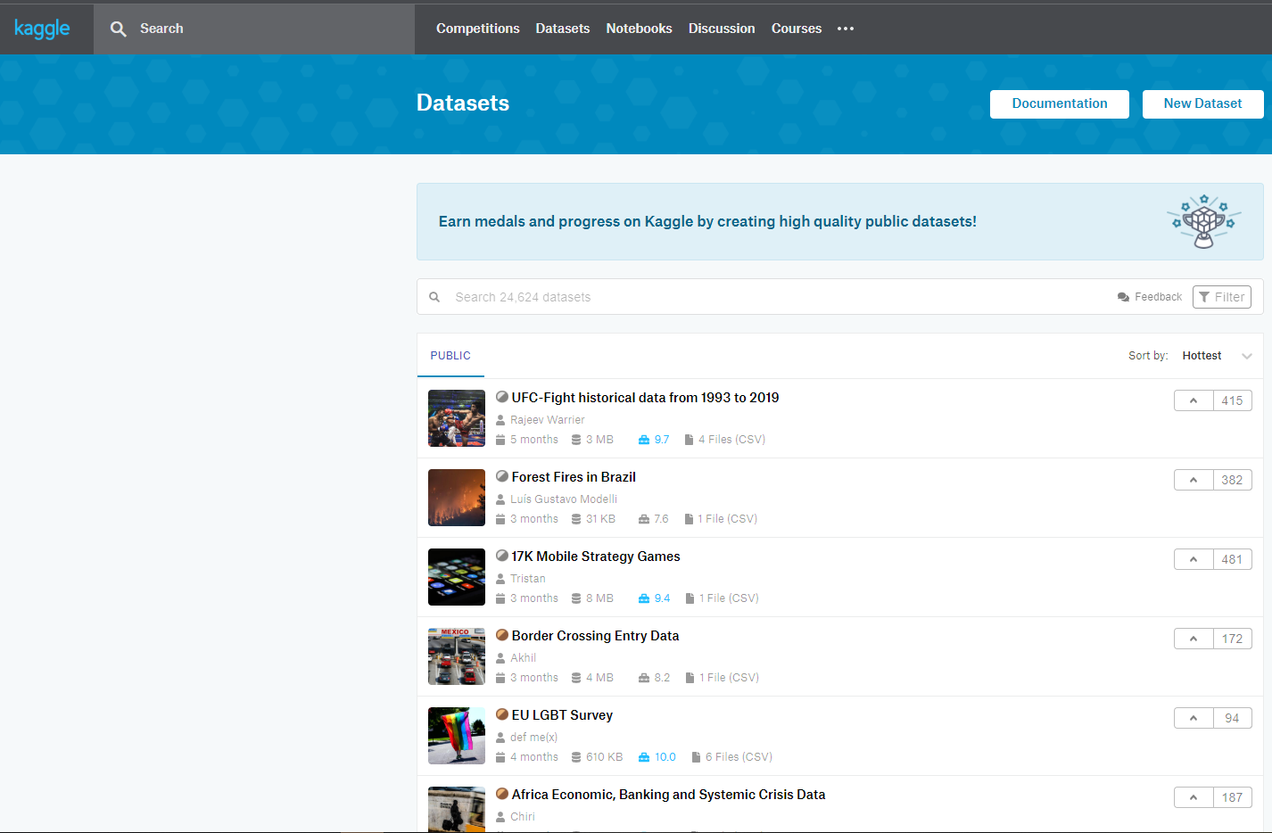
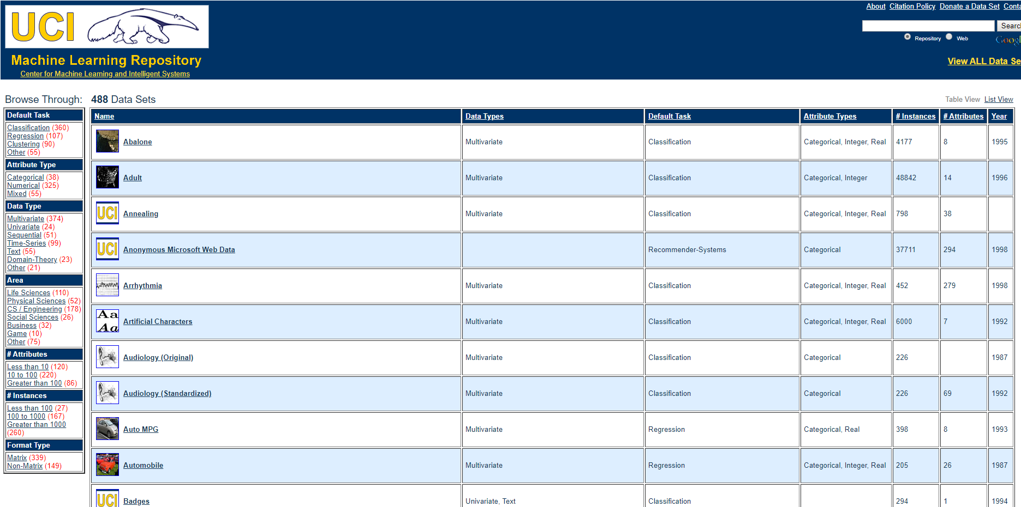
1. DATA: WHERE DOES THIS DATA COME FROM?
Data could also come from multiple sources such as Kaggle and University of California, Irvine (UCI).
Example: ImageNet is an open source repository of images consisting of 21,841 subcategories (classes) and over 14 million images.

Slide 27
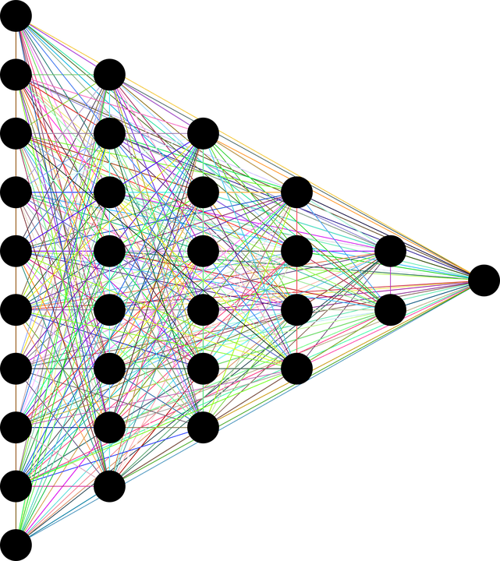

2. MODEL
The human brain consists of billions of neurons that communicate to each other using electrical/chemical signals and enable humans to see, feel, and make decision.
Artificial neural networks (ANNs) are information processing models inspired by the human brain.
Simply, ANNs are couple of equations that mimic the human brain!
INPUT DATA
OUTPUTS
DEEP (HIDDEN LAYERS)
MIMIC HUMAN BRAIN USING MATHEMATICAL EQUATIONS

Slide 28
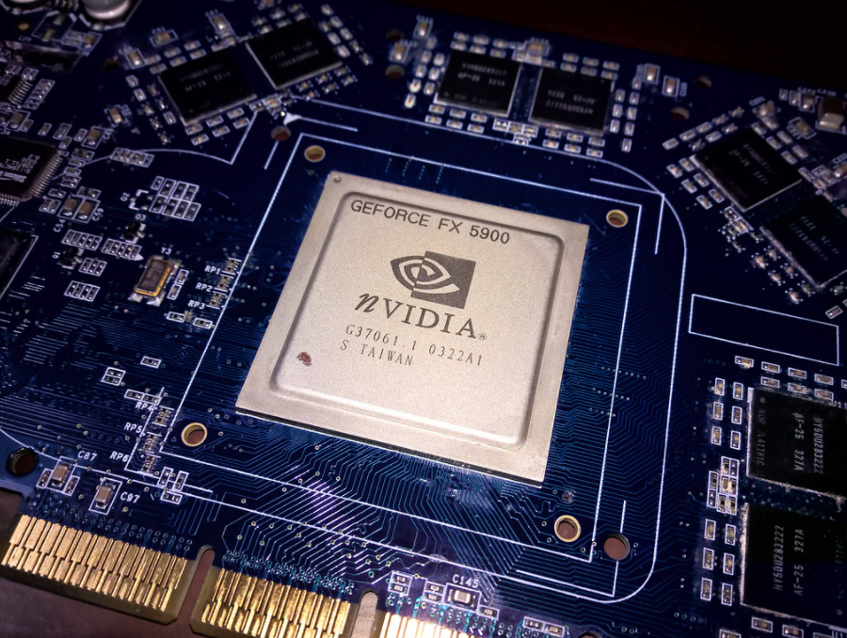
3. COMPUTE
ANN requires computation power to be able to learn from the data.
AI-based specific chips are being developed and optimized for AI training.
The amount of compute has been increasing exponentially with ~3 months doubling time!!
Great article by OpenAI: https://openai.com/blog/ai-and-compute/

Slide 29
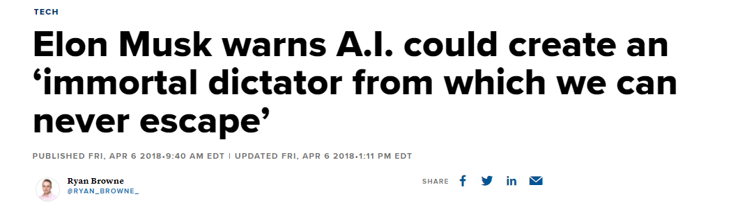
3. COMPUTE: AI IMMORTAL DICTATOR
“The least scary future I can think of is one where we have at least democratized AI because if one company or small group of people manages to develop godlike digital superintelligence, they could take over the world,” Elon Musk.

Slide 30
MACHINE LEARNING COMPONENTS IN AWS
EASY
ADVANCED

Slide 31
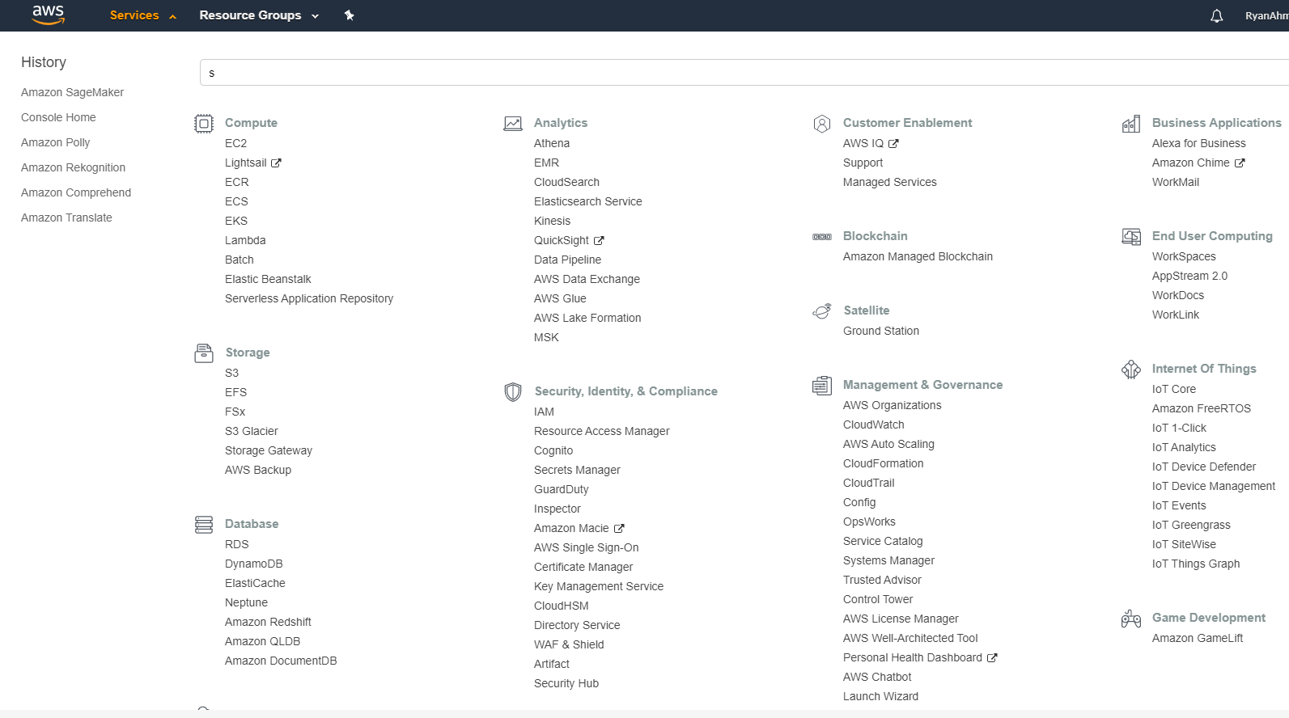
MACHINE LEARNING COMPONENTS IN AWS: 1. DATA
1. DATA
2. MODEL
3. COMPUTE
1

Slide 32
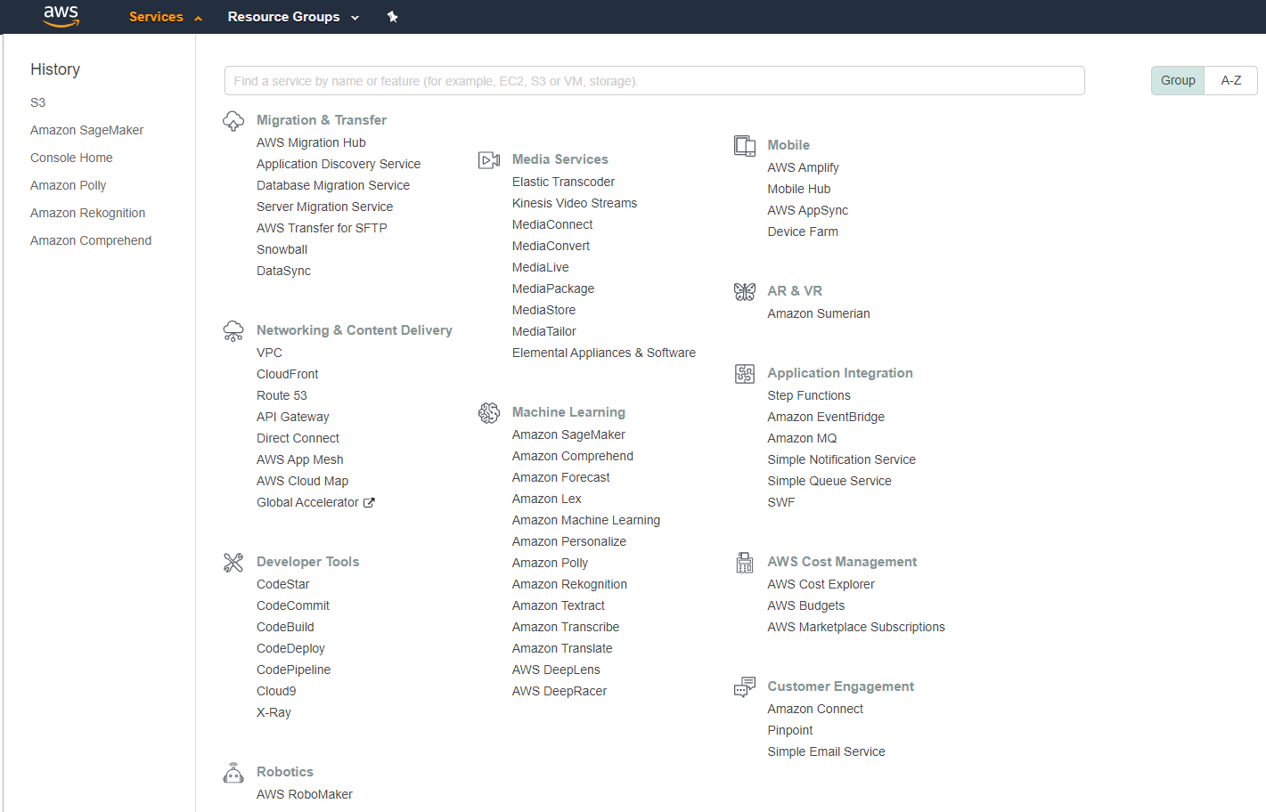
MACHINE LEARNING COMPONENTS IN AWS: 2. MODEL
1. DATA
2. MODEL
3. COMPUTE
2

Slide 33
MACHINE LEARNING COMPONENTS IN AWS: 3. COMPUTE
1. DATA
2. MODEL
3. COMPUTE
3

Slide 34
Thank you

